Slide 1

Principal Component Analysis (PCA)

Slide 2
Company | Market Cap ($M)
A | 3000
B | 120
C | 2500
D | 10
E | 72
F | 4000
Small Cap
Large Cap
D
E
B
C
A
F

Slide 3
Company | M-Cap ($M) | Revenue ($K)
A | 3000 | 400
B | 120 | 30
C | 2500 | 420
D | 10 | 3
E | 72 | 20
F | 4000 | 390
C
A
F
Revenue
B
E
D
Market Cap

Slide 4
Company | M-Cap ($M) | Revenue ($K) | Employees
A | 3000 | 400 | 42000
B | 120 | 30 | 200
C | 2500 | 420 | 13000
D | 10 | 3 | 32
E | 72 | 20 | 120
F | 4000 | 390 | 1900
F
C
A
Employees
Revenue
B
E
D
Market Cap

Slide 5
Company | M-Cap ($M) | Revenue ($K) | Employees | Number of Countries
A | 3000 | 400 | 42000 | 32
B | 120 | 30 | 200 | 7
C | 2500 | 420 | 13000 | 59
D | 10 | 3 | 32 | 4
E | 72 | 20 | 120 | 1
F | 4000 | 390 | 1900 | 115
?

Slide 6
Height | Alturo
6 | 595
4.5 | 460
7 | 700
3 | 290
10 | 995
12 | 1210
How many Dimensions?

Slide 7
Skidding Accidents | Snow Plow Expense | School Closures | Water Pipe Bursts | Patients with Heat Stroke | Geographic Area
. | . | . | .. | ... | A
... | ... | .. | ... | .. | B
... | .. | .. | .. | . | C
. | . | . | . | ... | A
How many Dimensions?

Slide 8
Skidding Accidents | Snow Plow Expense | School Closures | Water Pipe Bursts | Patients with Heat Stroke | Geographic Area
. | . | . | .. | ... | A
... | ... | .. | ... | .. | B
... | .. | .. | .. | . | C
. | . | . | . | ... | A
Temperature?

Slide 9
True Dimensionality << Observed Dimensionality

Slide 10
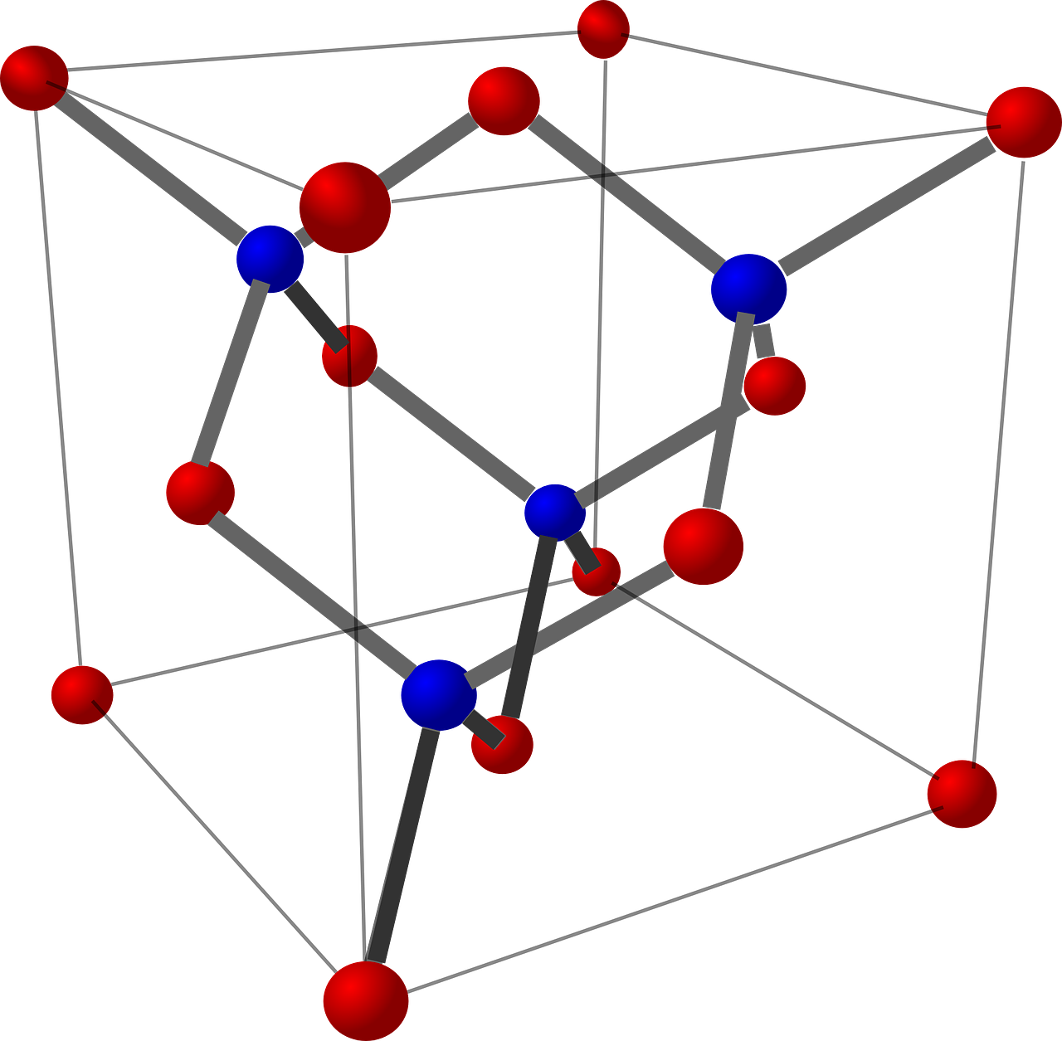
Curse of Dimensionality

Slide 11
Vision
1000 * 1000 Pixels
Text Documents
11 Billion Phrases in English

Slide 12
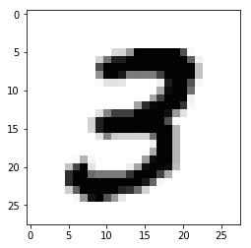
How many Dimensions?
How many possible values?

Slide 13
What possible problem does it create?

Slide 14
ML models use Statistics
10 Samples, 1 Dimension
How many regions?

Slide 15
ML models use Statistics
10 Samples, 2 Dimensions

Slide 16
ML models use Statistics
10 Samples, 3 Dimensions, 27 Regions

Slide 17
Dimensionality
Fewer Observations per region

Slide 18
How to deal with High dimensional Data?

Slide 19
Use Domain Expertise
Feature Engineering
Reduce Dimensionality of Data
Keep fewer features or Create new dimensions

Slide 20
Dimensionality Reduction
Represent each Sample with fewer Variables
Preserve most of the information in the Data

Slide 21
Feature Selection
Pick a Subset of Original features based on some criteria
- e.g Information gain
Feature Extraction
Create completely new set of Features e.g PCA

Slide 22
Principal Component Analysis (PCA)

Slide 23
 | F1 | F2 | F3 | F4
A | 11 | 6 | 12 | 5
B | 10 | 4 | 9 | 7
C | 8 | 5 | 10 | 6
D | 3 | 3 | 2 | 2
E | 2 | 3 | 1 | 4
F | 1 | 2 | 2 | 7
How can PCA help?

Slide 24
 | F1 | F2 | F3 | F4
A | 11 | 6 | 12 | 5
B | 10 | 4 | 9 | 7
C | 2 | 3 | 1 | 4
D | 8 | 5 | 10 | 6
E | 3 | 3 | 2 | 2
F | 1 | 2 | 2 | 7
A
B
D
PCA 2
C
B
E
PCA 1
Can make 2D Graph

Slide 25
 | F1 | F2 | F3 | F4
A | 11 | 6 | 12 | 5
B | 10 | 4 | 9 | 7
C | 8 | 5 | 10 | 6
D | 3 | 3 | 2 | 2
E | 2 | 3 | 1 | 4
F | 1 | 2 | 2 | 7
A
B
D
PCA 2
C
B
E
PCA 1
Which Feature is most important separating Examples

Slide 26
 | F1 | F2 | F3 | F4
A | 11 | 6 | 12 | 5
B | 10 | 4 | 9 | 7
C | 8 | 5 | 10 | 6
D | 3 | 3 | 2 | 2
E | 2 | 3 | 1 | 4
F | 1 | 2 | 2 | 7
A
B
D
PCA 2
C
B
E
PCA 1
How accurate the Graph is?

Slide 27
How PCA works?

Slide 28
 | F1 | F2
A | 11 | 6
B | 10 | 4
C | 2 | 3
D | 8 | 5
E | 3 | 3
F | 1 | 2
F 2
F1
Plot the Graph

Slide 29
 | F1 | F2
A | 11 | 6
B | 10 | 4
C | 2 | 3
D | 8 | 5
E | 3 | 3
F | 1 | 2
F 2
F1
Calculate feature(s) mean

Slide 30
 | F1 | F2
A | 11 | 6
B | 10 | 4
C | 2 | 3
D | 8 | 5
E | 3 | 3
F | 1 | 2
Mean | 5.83 | 3.83
F 2
F1
Calculate feature(s) mean

Slide 31
 | F1 | F2
A | 11 | 6
B | 10 | 4
C | 2 | 3
D | 8 | 5
E | 3 | 3
F | 1 | 2
Mean | 5.83 | 3.83
F 2
F1
Plot the mean

Slide 32
 | F1 | F2
A | 11 | 6
B | 10 | 4
C | 2 | 3
D | 8 | 5
E | 3 | 3
F | 1 | 2
Mean | 5.83 | 3.83
F 2
F1
Shift the Origin to Mean

Slide 33
F 2
F1
Shift the Origin to Mean

Slide 34
F 2
F1
Draw a line through Origin

Slide 35
F 2
F1
Rotate the line

Slide 36
F 2
F1
Keep rotating till best fit is found

Slide 37
F 2
F1
What does best fit here?

Slide 38
F 2
X
X
X
F1
X
X
X
Project Data points on the line

Slide 39
F 2
X
X
X
F1
X
X
X
Rotate line until Projections are minimum

Slide 40
F 2
X
d₁
X
d₂
X
F1
X
X
X
OR distance from Origin is Maximum

Slide 41
F 2
X
d₁
X
d₂
X
F1
X
X
X
How do we compare distances?

Slide 42
Sum of Square distances = d₁ ² + d₂ ² + d₃ ² + d₄ ² + d₅ ² + d₆ ²
F 2
X
d₁
X
d₂
X
F1
X
X
X
How do we compare distances?

Slide 43
F 2
F1
Best fit line is called ‘PC 1’

Slide 44
F 2
3
X
1.5
F1
Calculate Ratio of F1 and F2 for Best Fit line

Slide 45
F 2
3
X
1.5
F1
F1 is 2 times more important than F2

Slide 46
3
F 2
1.5
3
X
1.5
F1
F1 is 2 times more important than F2

Slide 47
EigenVector for PC 1
3
1
F 2
1.5
0.5
3
X
1.5
F1
Make it a Unit Vector

Slide 48
EigenVector for PC 1
3
1
F 2
1.5
0.5
3
X
1.5
F1
EigenValue for PC 1
Sum of Square distances = d₁ ² + d₂ ² + d₃ ² + d₄ ² + d₅ ² + d₆ ²

Slide 49
So far ...
Calculate mean of each feature
Subtract mean (Move origin)
Draw random line and Project points
Calculate Sum of Square distances from Origin to Projection
Rotate line for Best fit (maximum SSD) - PC 1
Find Feature ratio to get Feature importance
Calculate Unit Vector - EigenVector for PC 1
Find SSD for PC1 - EigenValue of PC1

Slide 50
What’s Next?

Slide 51
F 2
F1
Draw a Perpendicular line to PC 1

Slide 52
F 2
F1
This is PC 2

Slide 53
F 2
F1
Calculate EigenValue and EigenVector for PC2

Slide 54
What’s the role of EigenValue?

Slide 55
Variance in the original data captured by PC 1
PC 1
18
85.5%
PC 2
3
14.5%
Variance in the original data captured by PC 2

Slide 56
What are the new Dimensions or Features?

Slide 57
F 2
F1
PC 1 Dimension

Slide 58
F 2
F1
PC 2 Dimension

Slide 59
PC 2 - 14.5%
PC 1 - 85.5%
PC1, PC2 are new Dimensions

Slide 60
PC 1 - 85.5%
Dimensionality Reduction

Slide 61
 | F1 | F2 | F3
A | 11 | 6 | 12
B | 10 | 4 | 9
C | 8 | 5 | 10
D | 3 | 3 | 2
E | 2 | 3 | 1
F | 1 | 2 | 2
 | F1 | F2 | F3 | F4
A | 11 | 6 | 12 | 5
B | 10 | 4 | 9 | 7
C | 8 | 5 | 10 | 6
D | 3 | 3 | 2 | 2
E | 2 | 3 | 1 | 4
F | 1 | 2 | 2 | 7

Slide 62
Calculate EigenVectors
Calculate EigenValues

Slide 63
How many EigenVectors and EigenValues?

Slide 64
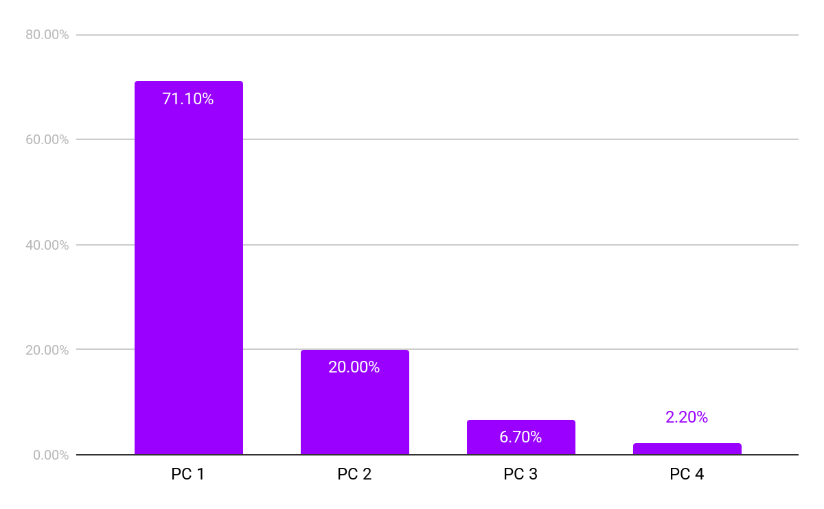
 | EigenValue | %Variance
PC1 | 32 | 71.1%
PC2 | 9 | 20.0%
PC3 | 3 | 6.7%
PC4 | 1 | 2.2%

Slide 65
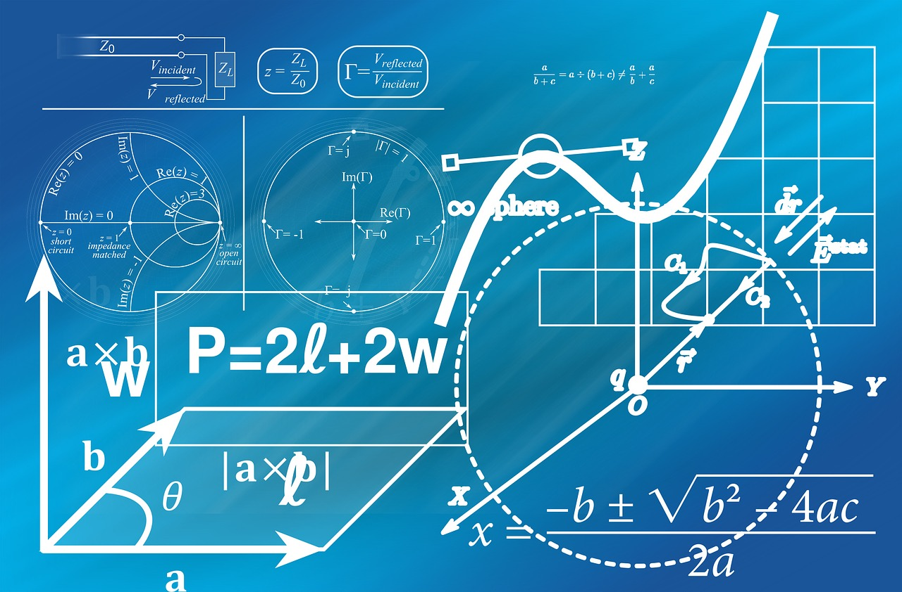
Math of PCA

Slide 66
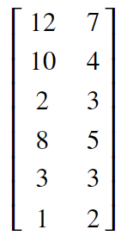
 | F1 | F2
A | 12 | 7
B | 10 | 4
C | 2 | 3
D | 8 | 5
E | 3 | 3
F | 1 | 2
The Matrix

Slide 67
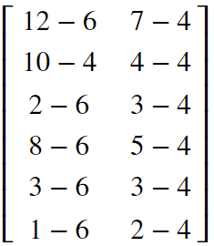
 | F1 | F2
A | 12 | 7
B | 10 | 4
C | 2 | 3
D | 8 | 5
E | 3 | 3
F | 1 | 2
Mean | 6 | 4
Calculate Mean

Slide 68
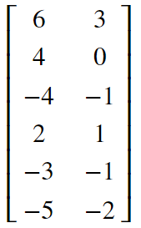
 | F1 | F2
A | 12 | 7
B | 10 | 4
C | 2 | 3
D | 8 | 5
E | 3 | 3
F | 1 | 2
Mean | 6 | 4
Mean after shift?

Slide 69
Variance & Covariance

Slide 70
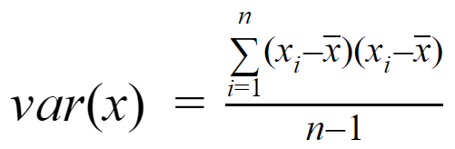
Variance
Measure of spread of data in feature...

Slide 71
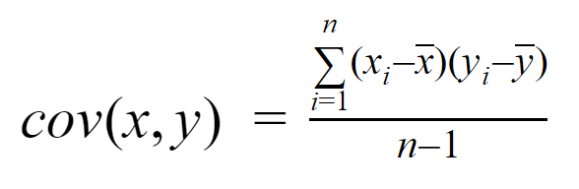
Covariance
How two features move together in a dataset...

Slide 72
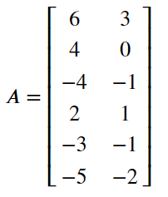
Using Matrix Multiplication to get Covariance Matrix

Slide 73
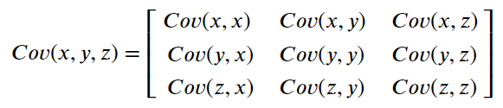


Slide 74
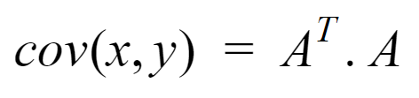

Slide 75
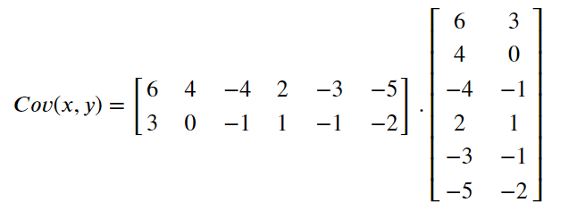
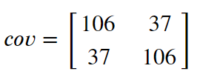
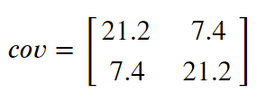

Slide 76
EigenVector and EigenValues of Covariance Matrix

Slide 77

Covariance Matrix
EigenValue
EigenVector

Slide 78




Slide 79





Slide 80




Slide 81
How to Solve this :)

Slide 82

λ = 28.6 and λ = 13.8
What does λ represent?

Slide 83
EigenVector or Principal Components

Slide 84



Slide 85



Slide 86




Slide 87
Improving Classification with PCA

Slide 88
Dimensionality Reduction with PCA

Slide 89
Noise Reduction with PCA

Slide 90
EigenFaces

Slide 91
Dimensionality Reduction
Advantages ...
Allows working with High Dimensional Data
Reduced Dataset size
Faster Processing
Disadvantages...
Computationally Expensive for Large feature space
Linear combination will struggle to handle non-linear relationship between features

